Slide 1
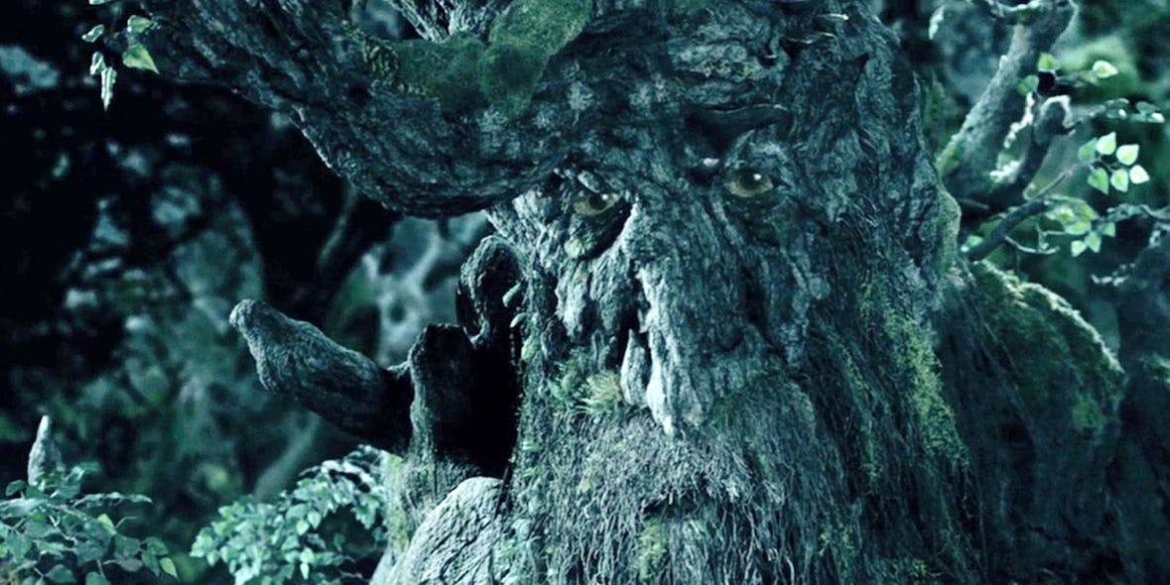
SOEE1475 Statistics and Data Analysis
Lecture 6: Temporal statistics
Graeme T. Lloyd

Slide 2

Today
Temporal patterns
Kolmogorov-Smirnov test
Markov chains

Slide 3
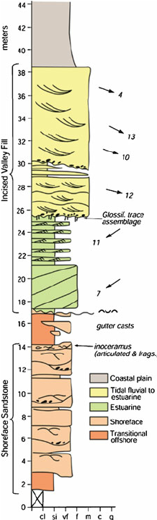
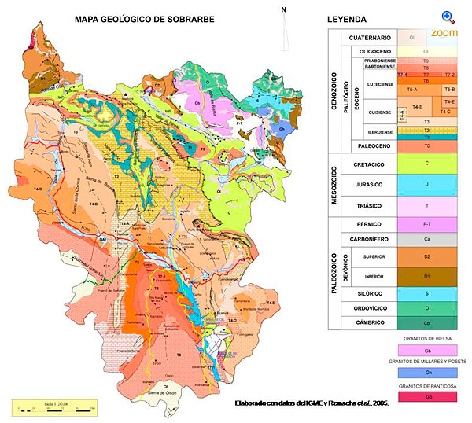
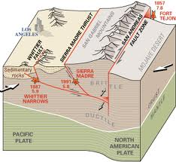
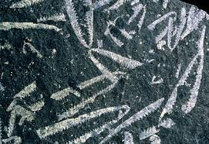
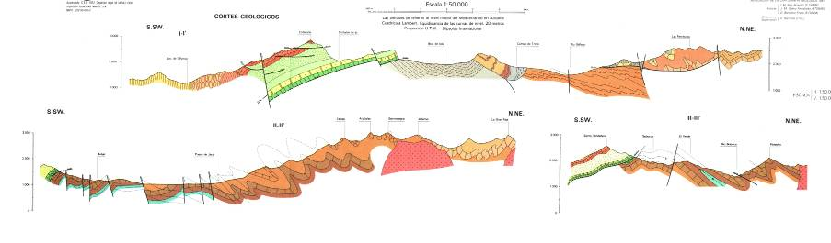
Spatial data in geology
1D
2D
3D

Slide 4
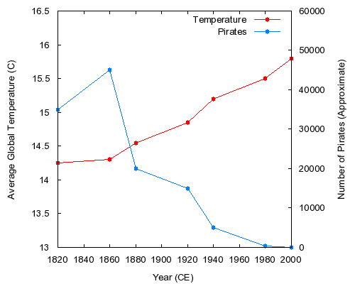


Temporal autocorrelation
cor.test(x = pirates,
y = temp)$estimate
-0.9242241
cor.test(x = pirates,
y = temp)$p.value
0.00291353

Slide 5
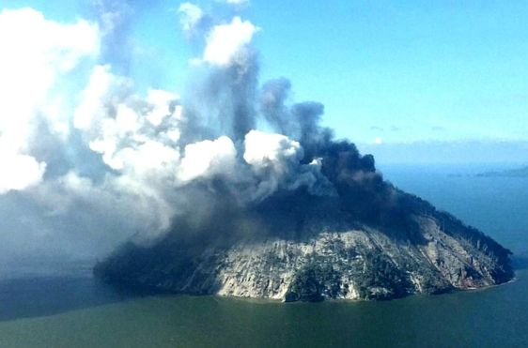
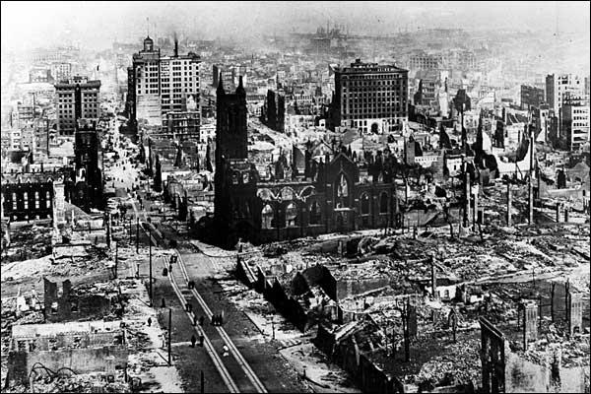
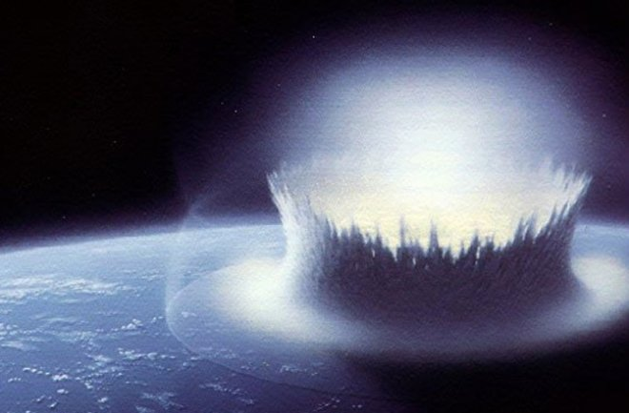
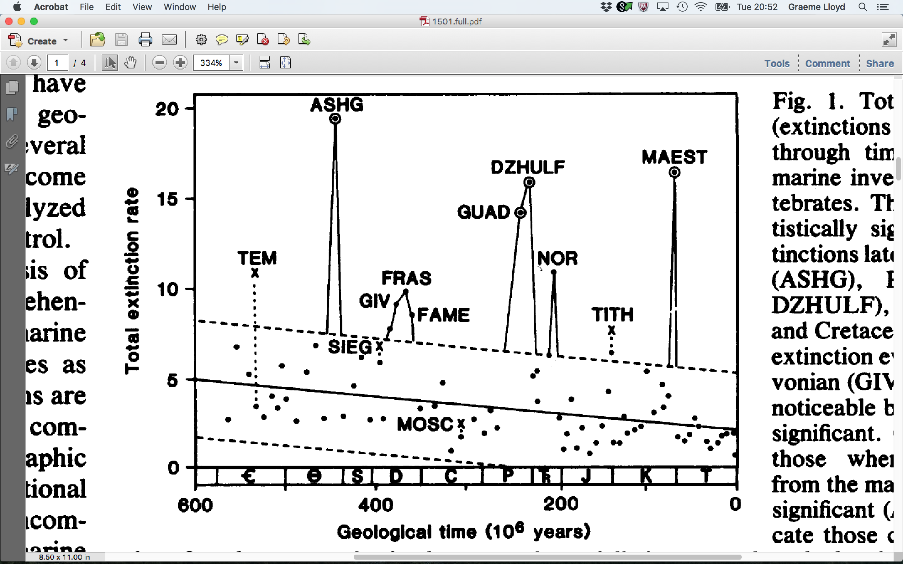
Series of events

Slide 6
Series of events
Regular/uniform
Random
Clustered
Trend
Pattern

Slide 7
Testing for regular/uniform
Regular/uniform
Cumulative events
Time

Slide 8
Testing for regular/uniform
Continuous uniform
Probability density function
Continuous uniform
Cumulative distribution function
a
b
a
b
f(x)
0
1

Slide 9
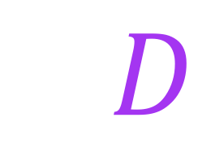
Kolmogorov-Smirnov test
Regular/uniform
Cumulative events
$$D$$
Time

Slide 10
Kolmogorov-Smirnov test
$$0≤D≤1$$

Slide 11
Kolmogorov-Smirnov test
$$0≤D≤1$$

Slide 12
Kolmogorov-Smirnov test
x <- runif(20)
ks.test(x = x, y = "punif")$statistic
ks.test(x = x, y = "punif")$p.value

Slide 13
Kolmogorov-Smirnov test
Assesses “goodness of fit” between two distributions
Like Chi-squared, but for continuous rather than categorical data
Allows us to choose expected value (null model)
Also like Chi-squared; flexible
One way to test if data approximate a specific distribution type
E.g., are data uniform? Are data normal?

Slide 14
Kolmogorov-Smirnov test
One-sample
ks.test(x = runif(20), y = "punif")
ks.test(x = runif(20), y = "pnorm")
Two sample
ks.test(x = runif(20), y = runif(20))
ks.test(x = runif(20), y = rnorm(20))

Slide 15
Testing for random
Random
1
1
0
2
1
0
0
1
1
1
1
1
Expected?

Slide 16
Testing for random
Poisson distribution
$$P(X=x)=\frac{λ^{k}e^{−λ}}{k!}$$
Has single parameter ($λ$), the mean
Expresses probability of given number of events
Assumes randomness; events can occur in space or time
Good null for random distribution of points in space time
I.e., in example expected N time bins with k events

Slide 17
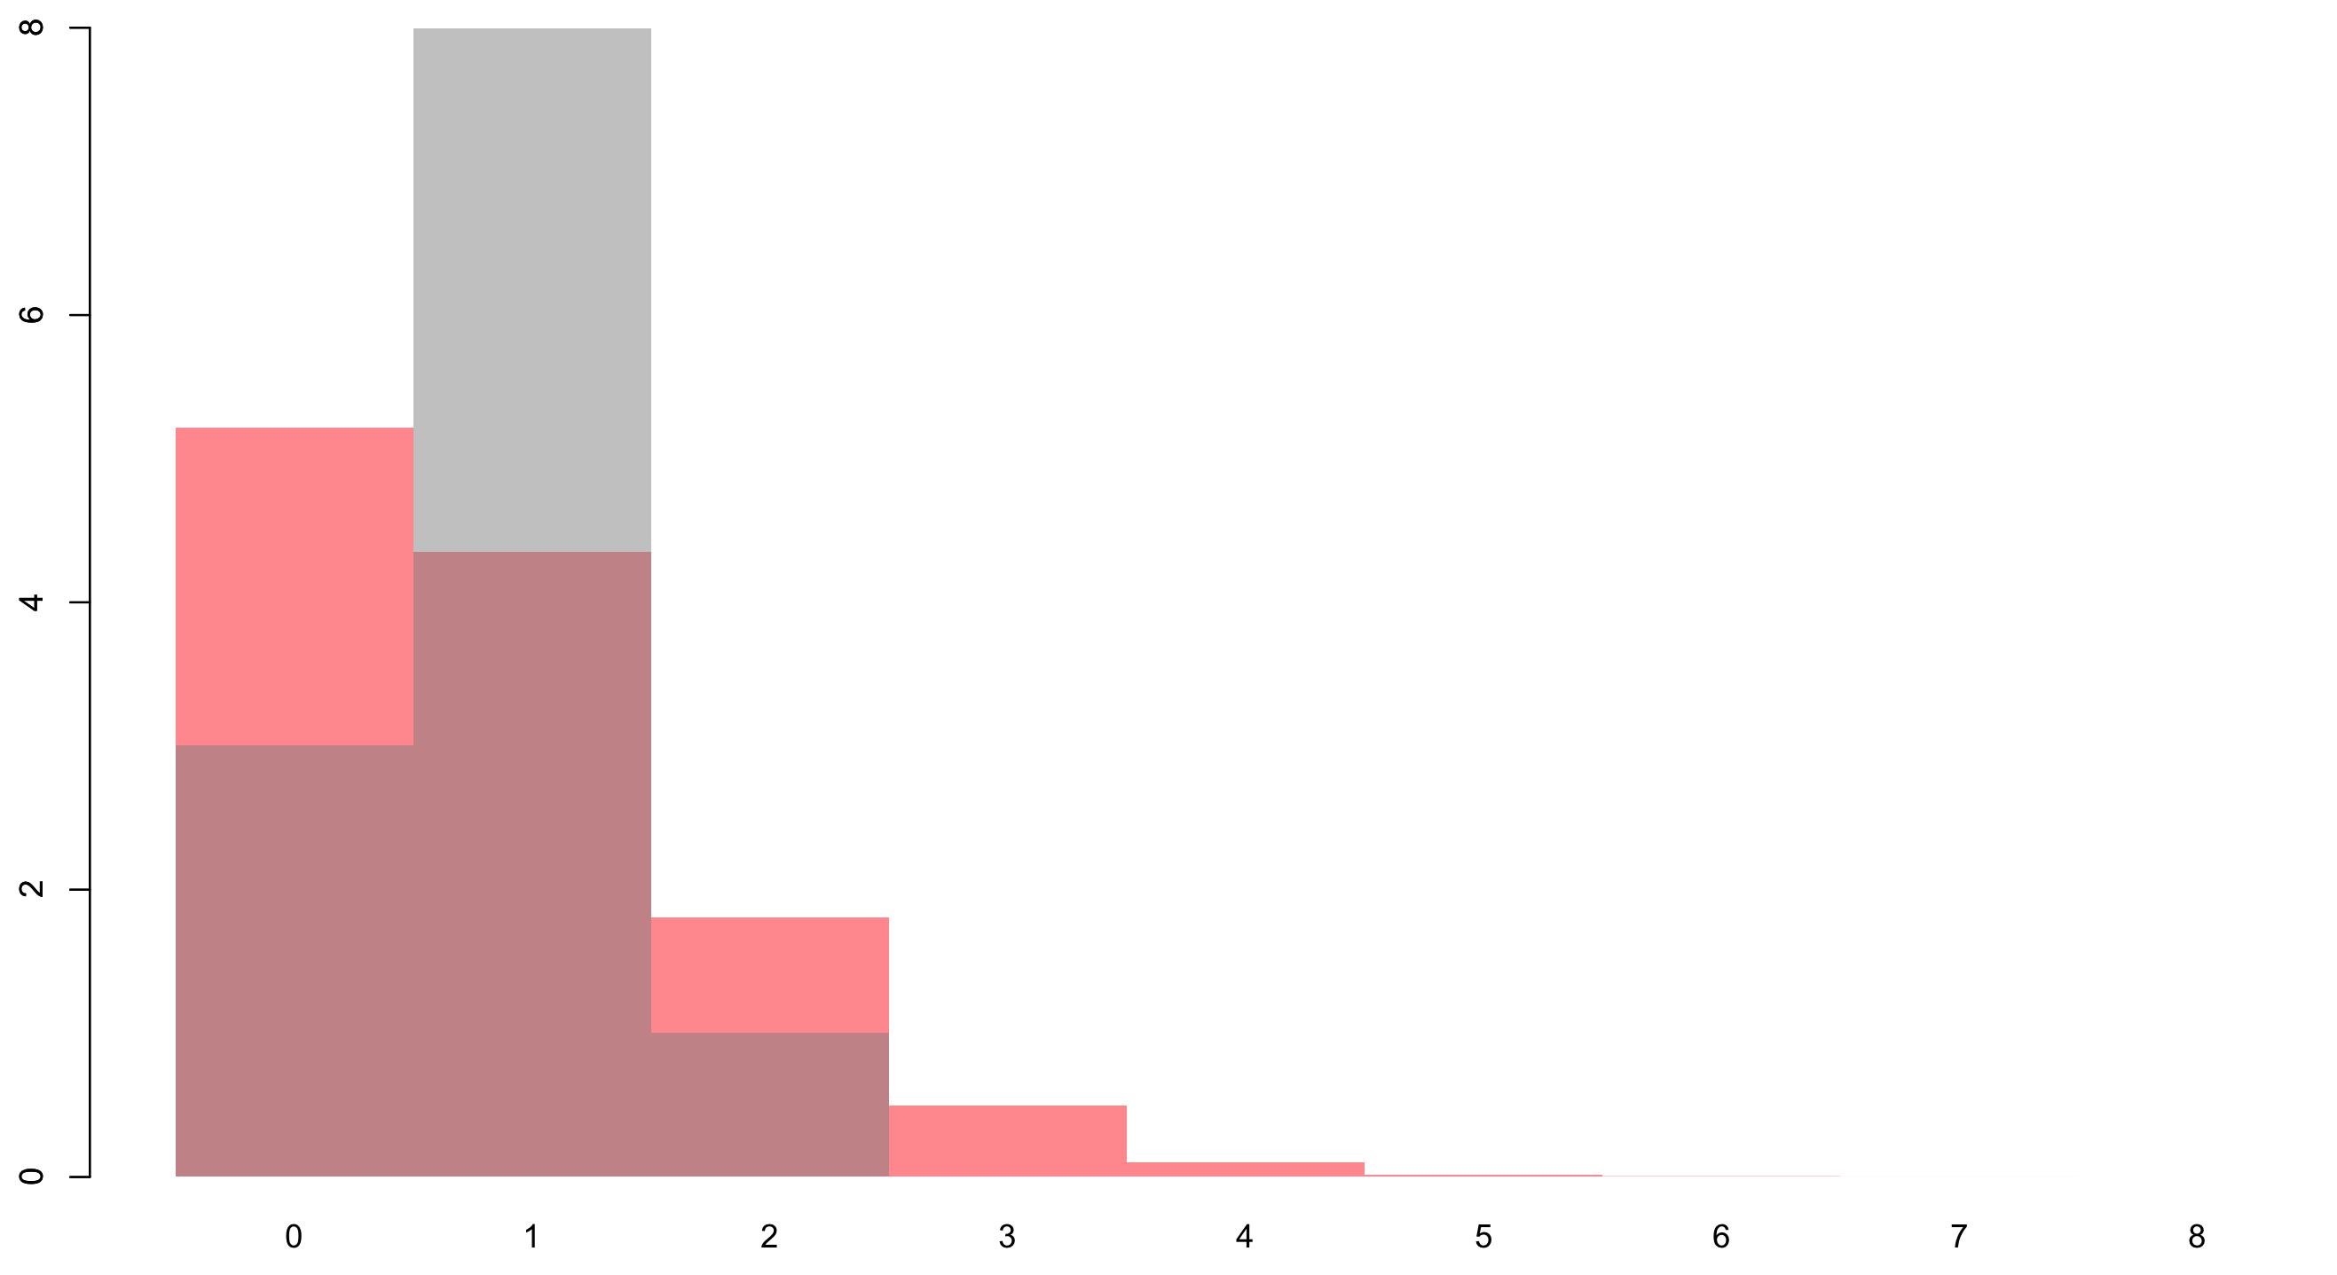
Testing for random
O_{j}
E_{j}

Slide 18
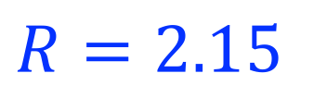
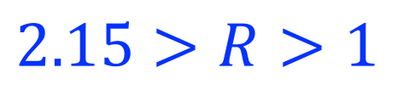
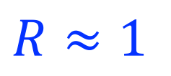
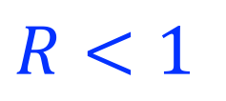
Testing for clustered
Clustered
Regular
Uniform
Random
Clustered
$$R=2.15$$
$$2.15>R>1$$
$$R≈1$$
$$R<1$$

Slide 19
Testing for clustered
Clustered

Slide 20
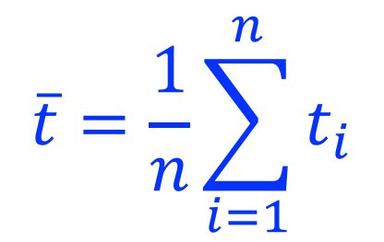
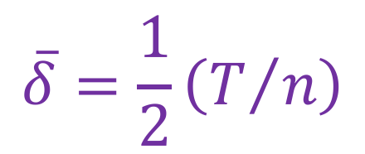
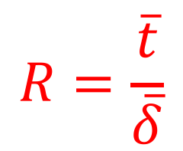
Testing for clustered
Mean nearest neighbour time
$$\overline{t}=\frac{1}{n}\sum_{i=1}^{n}{t_{i}}$$
Captures average time to nearest event
Expected mean nearest neighbour time
$$\overline{δ}=\frac{1}{2}\left(T/n\right)$$
Uses total time (T) and number of events (n)
Nearest neighbour statistic
$$R=\frac{\overline{t}}{\overline{δ}}$$
Varies from 0 to c. 2

Slide 21
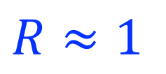
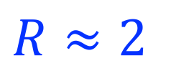
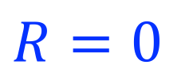
Testing for clustered
Regular
$$R≈2$$
Random
$$R≈1$$
Clustered
Point
$$R=0$$

Slide 22
Testing for trend
Trend
t_{i} – t_{i-1}
Event order

Slide 23
Testing for trend
Trend
t_{i} – t_{i-1}
Event order

Slide 24
Testing for trend
-1
0
1
Increasing event
frequency
Decreasing event
frequency

Slide 25
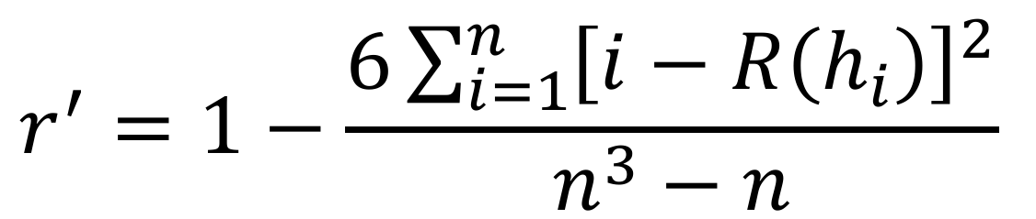
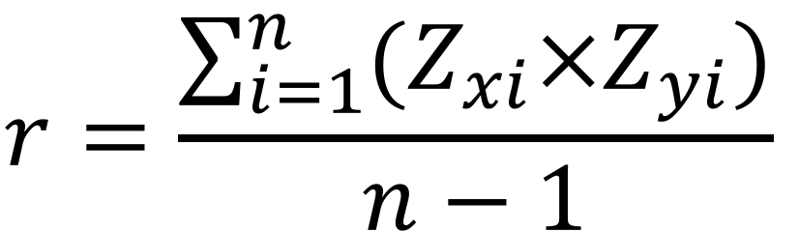
Testing for trend
Pearson correlation coefficient, r
PARAMETRIC
$$r=\frac{\sum_{i=1}^{n}{(Z_{xi}×Z_{yi})}}{n−1}$$
Spearman rank correlation coefficient, r’
NON-PARAMETRIC
$$r^{′}=1−\frac{6\sum_{i=1}^{n}{{\left[i−R\left(h_{i}\right)\right]}^{2}}}{n^{3}−n}$$

Slide 26
Testing for trend
Spearman rank correlation coefficient, r’
cor.test(x = x, y = y, type = "spearman")$estimate
cor.test(x = x, y = y, type = "spearman")$p.value

Slide 27
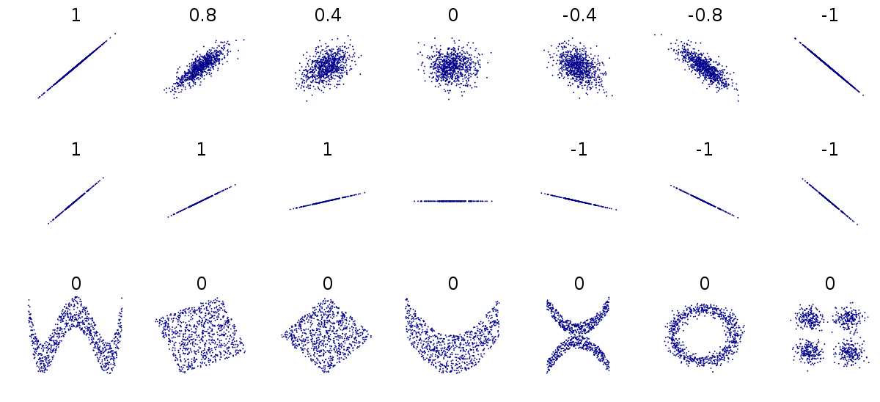
Testing for trend

Slide 28
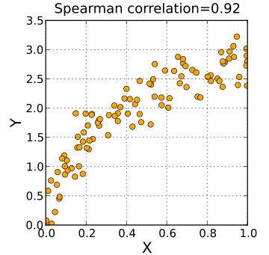
Testing for trend

Slide 29
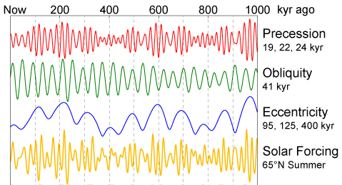
Testing for pattern
Pattern

Slide 30
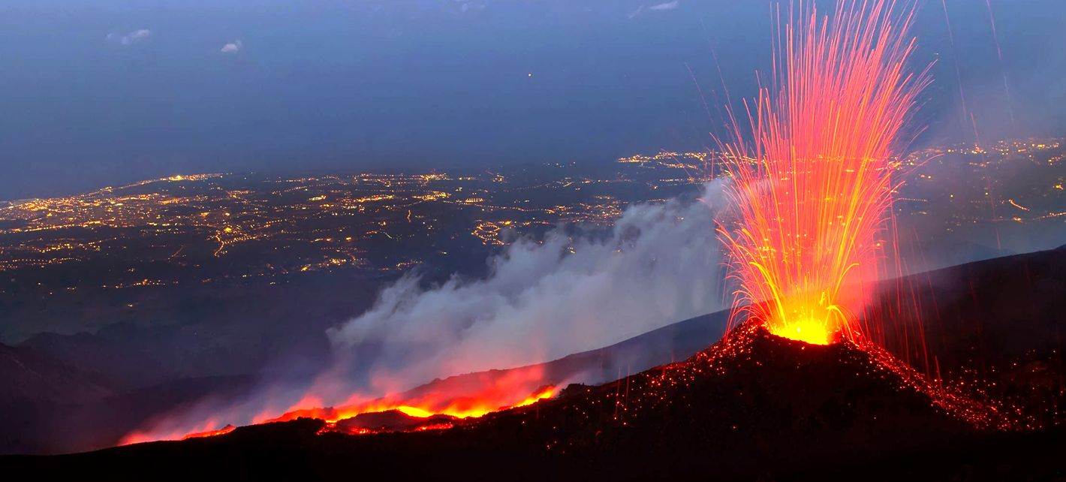
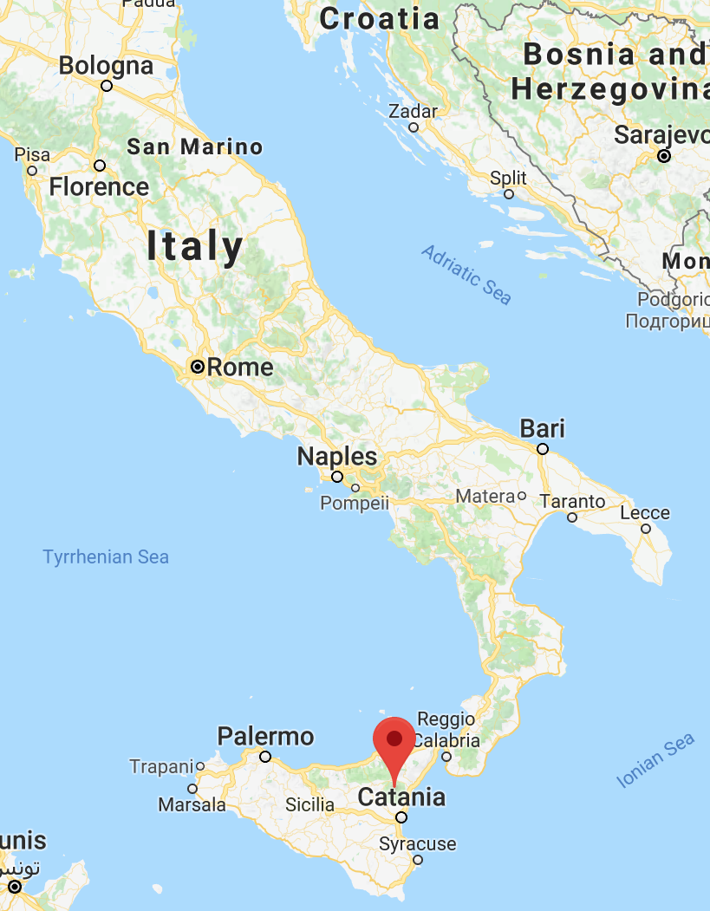
Exercise

Slide 31
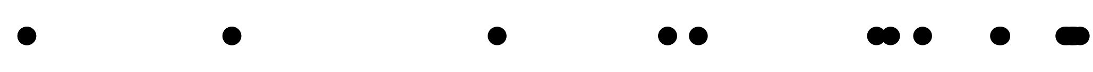
Exercise
EtnaEruptionYears <- c(1169, 1169, 1329, 1329, 1536, 1669, 1669,
1693, 1832, 1843, 1868, 1928, 1929, 1979, 1981, 1984, 1985,
1987, 1991)
1000
2000

Slide 32
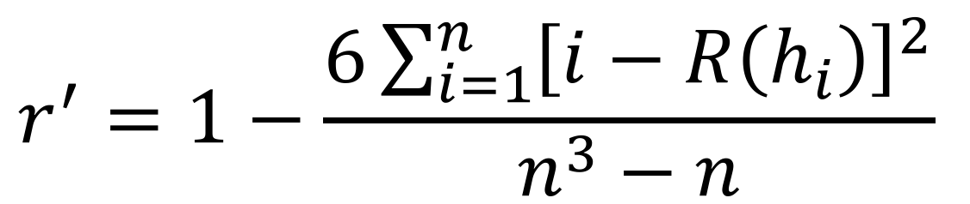
Exercise
$$r^{′}=1−\frac{6\sum_{i=1}^{n}{{\left[i−R\left(h_{i}\right)\right]}^{2}}}{n^{3}−n}$$
diff(EtnaEruptionYears)
0 160 0 207 133 0 24 139 11 25 60 1 50 2 3 1 2 4
rank(diff(EtnaEruptionYears))
2 17 2 18 15 2 11 16 10 12 14 4.5 13 6.5 8 4.5 6.5 9
1:18 # temporal rank order of eruptions
1 2 3 4 5 6 7 8 9 10 11 12 13 14 15 16 17 18

Slide 33
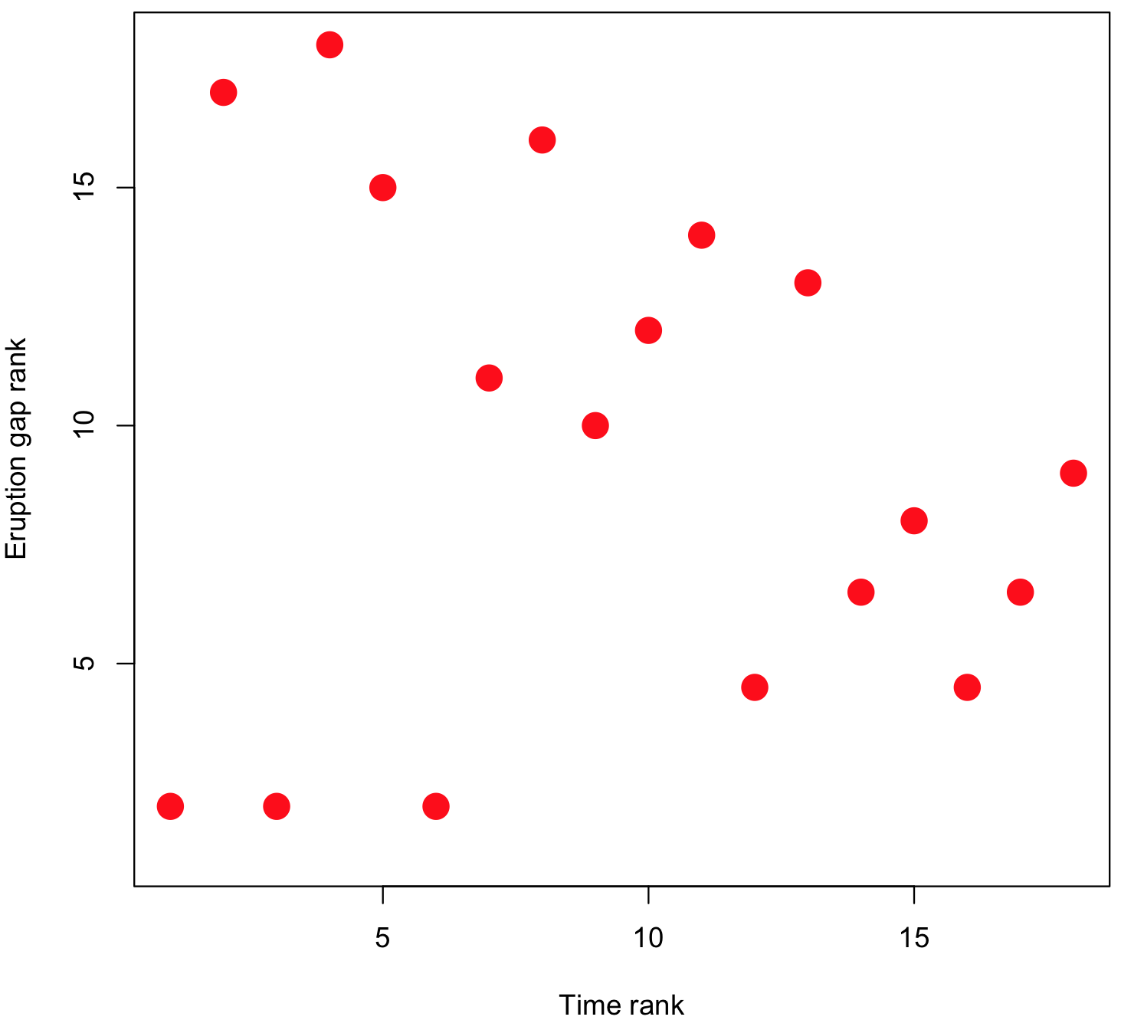
Exercise

Slide 34
Markov chains
p(A -> B) = 1
A
B
p(B -> A) = 1
A
B
A
B
A
B
A
B
A
B
A
B
A
B
A
B
A
B
A
B

Slide 35
Markov chains
A
B

Slide 36
Markov chains
p(A -> B) = 0.5
p(A -> A) = 0.5
A
B
p(B -> B) = 0.5
p(B -> A) = 0.5
A
A
B
A
B
B
A
A
A
B
A
B
B
A
B
A
A
B
B
A

Slide 37
Markov chains
p(A -> B) = ?
p(A -> A) = ?
A
B
p(B -> B) = ?
p(B -> A) = ?
A
A
B
A
B
B
A
A
A
B
A
B
B
A
B
A
A
B
B
A

Slide 38
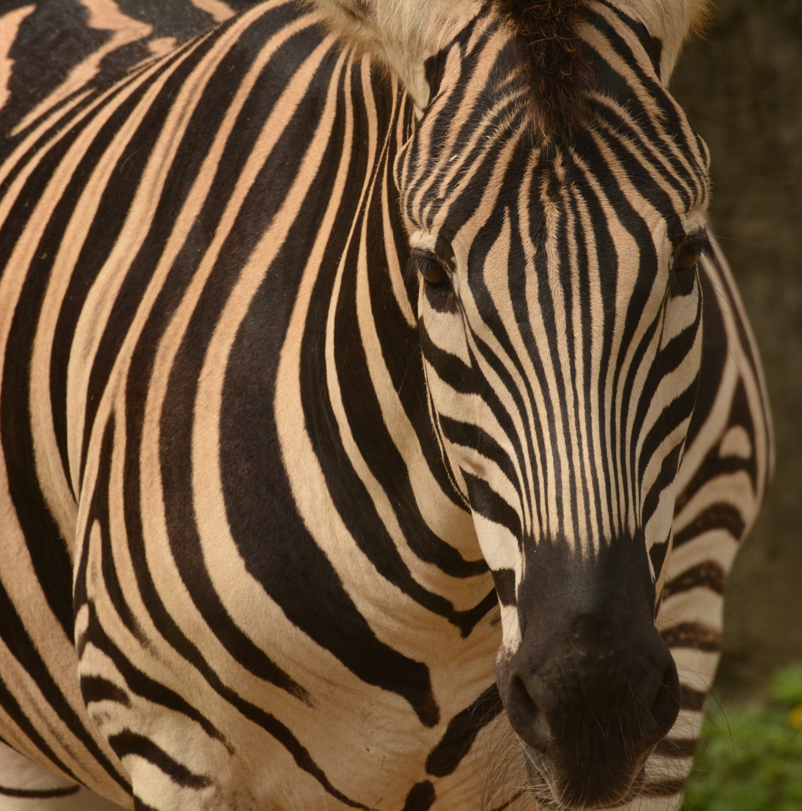
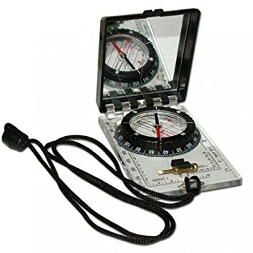
Markov chains

Slide 39
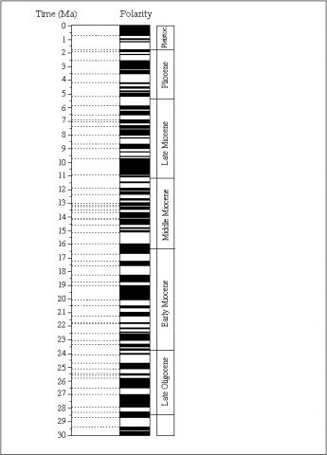
Markov chains
Normal
p(N -> R) = ?
Reversed
p(N -> N) = ?
N
R
p(R -> R) = ?
p(R -> N) = ?

Slide 40
Markov chains
3
p(N -> N) = 3 / (3 + 5) = 0.375
5
p(N -> R) = 5 / (3 + 5) = 0.625
5
p(R -> R) = 5 / (5 + 5) = 0.500
5
p(R -> N) = 5 / (5 + 5) = 0.500

Slide 41
Markov chains
Transition frequency matrix
Transition probability matrix
To
To
3
5
0.375
0.625
From
From
5
5
0.500
0.500

Slide 42
Markov chains
A
B
C

Slide 43
Markov chains
A
B
C
D

Slide 44
Markov chains
A
B
A
A
B
B
C
C
D

Slide 45
Markov chains
Sedimentary sequence
No clear pattern
Rhythmic sedimentation

Slide 46
Markov chains
Sandstone
Shale
No clear pattern
Rhythmic sedimentation
Coal
Limestone

Slide 47
Markov chains
Transition freq. matrix
Transition freq. matrix
2
1
1
2
0
6
0
0
No clear pattern
2
2
Rhythmic sedimentation
0
0
6
0
1
1
1
2
1
1
0
0
0
6
1
1
2
2
6
0
0
0

Slide 48
Markov chains
Transition prob. matrix
Transition prob. matrix
0.3
0.2
0.2
0.3
0
1
0
0
No clear pattern
0.3
0.3
Rhythmic sedimentation
0
0
1
0
0.2
0.2
0.2
0.3
0.2
0.2
0
0
0
1
0.2
0.2
0.3
0.3
1
0
0
0

Slide 49
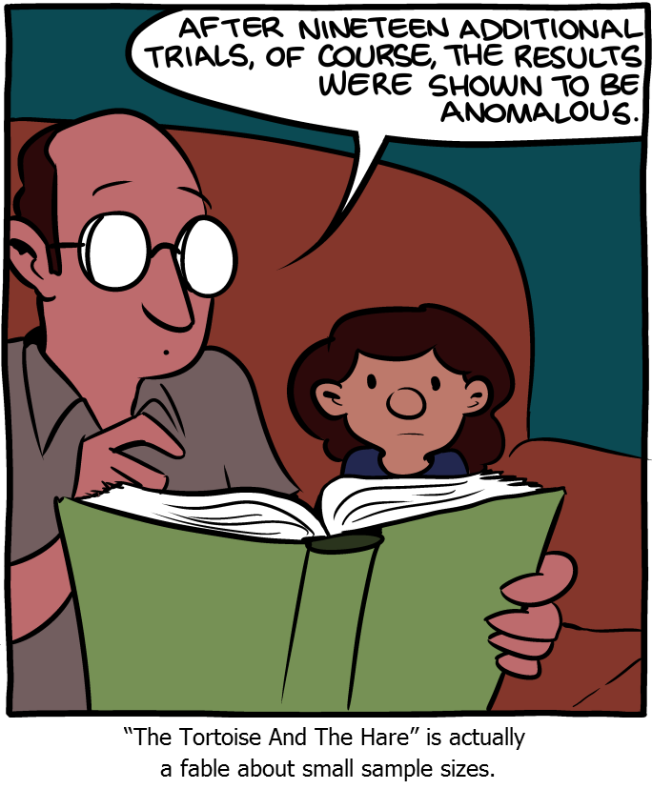
The importance of multiple replicates
Source: SMBC

